Slide 1
Experimental evaluation of a DASH implementation
Arka Deb​ (A20386958),
Noor Afshan Fathima​ (A20385838)​

Slide 2
Introduction
Internet video makes up a significant part of the internet traffic and its fraction is constantly growing
Cisco recently unveiled a report showing that by 2019, on-line video will be responsible for 80% of global Internet traffic
Movies, Video Series, Concert videos, User generated content videos over social media, education videos, advertising videos, Gameplay videos etc.

Slide 3
Streaming Stored Video
Pre-recorded videos are placed on servers and users send request to these servers to view the videos on demand
Watch beginning to end without interruption, stop watching before end, interact : pause, reposition to future or past scene, fast forward
Categories:
UDP Streaming
HTTP streaming
Adaptive HTTP streaming
Common characteristic: client-side application buffering

Slide 4
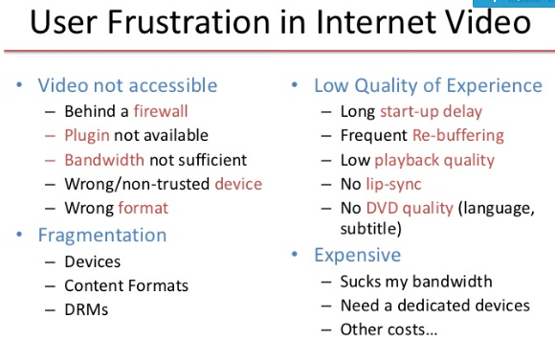

Slide 5
Fundamental Problem
Solution
How can you maintain seamless video and audio playback over a network that can not guarantee quality of service ?
A streaming algorithm that adjusts to the bandwidth available on the network.

Slide 6
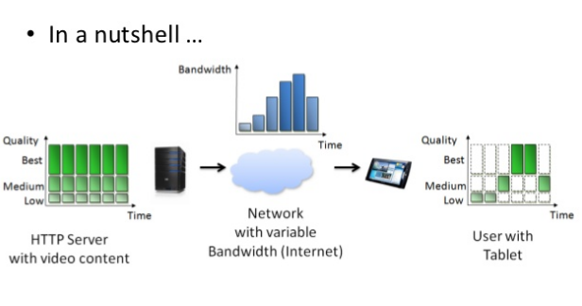
Adaptive Streaming and DASH

Slide 7
Adaptive Streaming and DASH
Adaptive streaming technologies enable the optimum streaming video viewing experience for a diverse range of devices over a broad set of connection speeds.
They produce multiple files from the same source file to distribute to viewers watching on different powered devices via different connection speeds.
They distribute the files adaptively, changing the stream that’s delivered to adapt to changes in effective throughput and available CPU cycles on the playback station.

Slide 8


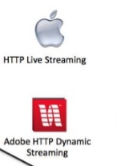


DASH in practise

Slide 9
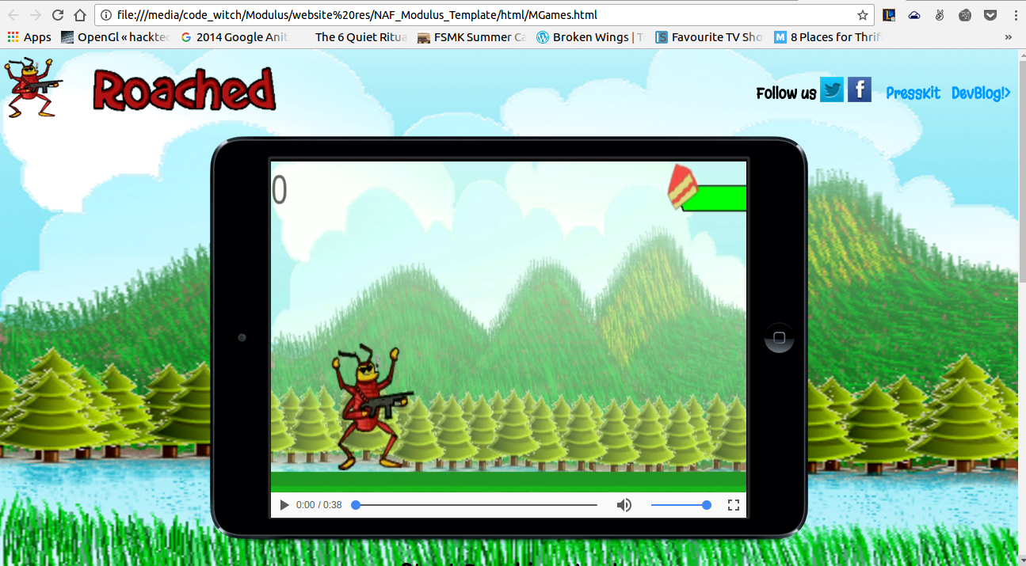
Landing Page streaming our Gameplay video

Slide 10
SYSTEM MODEL
Media content encoded in different versions eg. different bitrates, resolutions, etc.
Each version chopped into segments.
Each Segment individually accessed by the client via HTTP-GET request.
Each Segment available in different Representation e.g. different quality level, spatial resolution, etc.
Set of representations obtained by downloading MPD (Media Presentation Description).
After download it is decoded and presented to user.

Slide 11
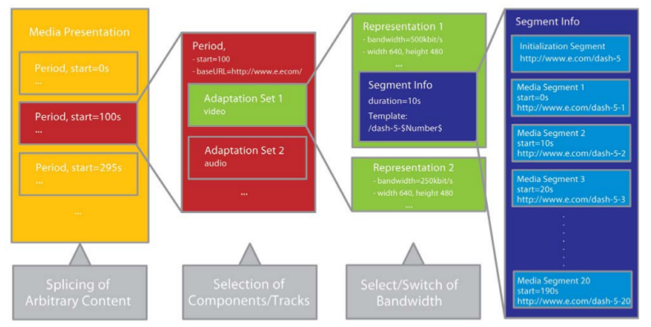
Media Presentation Description

Slide 12
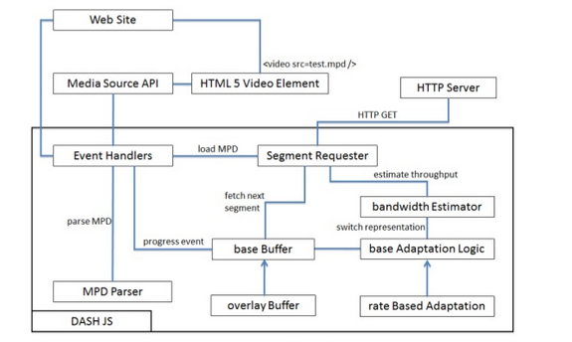
DASH-JS Architecture

Slide 13

x264
x264 is an implementation of MPEG4 Part 10, also known as AVC or H264. x264 command (re-) encodes the video in H.264/AVC with the properties we will need.
x264 provides a command line interface as well as an API.
We first experimented with x264 for (re-) encoding a raw mp4.

Slide 14




ffmpeg
It is a very fast video and audio converter. It is used to encode video and pack it to different containers(MP4, MOV, AVI, WMV). It is also more than this. ffmpeg can be seen as a set of libraries allowing you to virtually read any media container using any codec (video or audio).

Slide 15
GPAC’s MP4Box
Multimedia packager available in GPAC.
Used for interleaving, fragmentation and segmentation of video files.

Slide 16
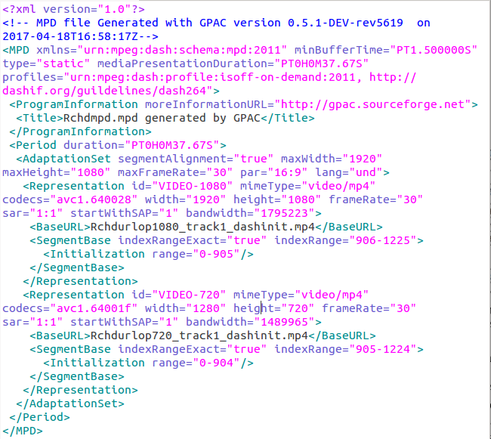
Snippet of generated MPD

Slide 17
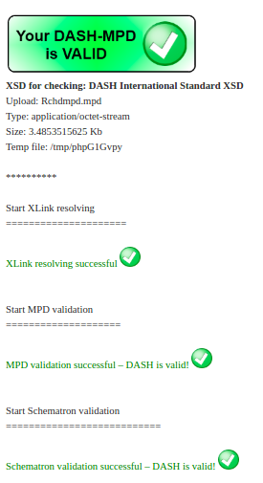
MPD Validation

Slide 18
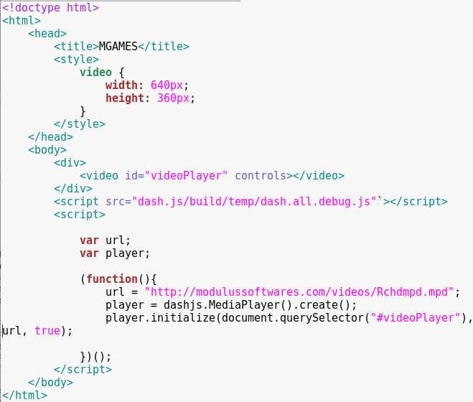
MPEG-DASH player in website

Slide 19
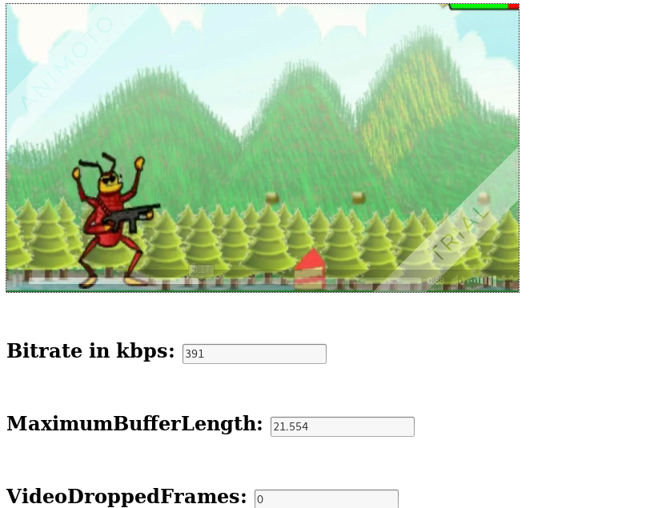
DASH-JS Client Implementation

Slide 20
Hosting
Local : Debian Host running Apache Web Server.
External : Linux Web Server.

Slide 21
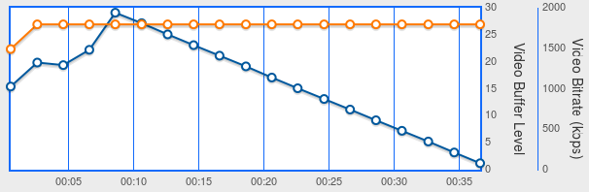
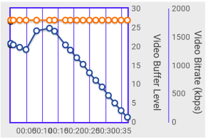
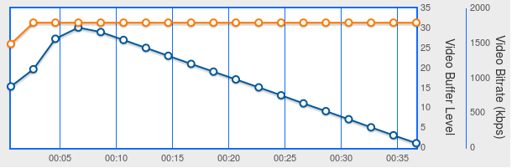
Sample analysis graphs
Single User
Double Users

Slide 22
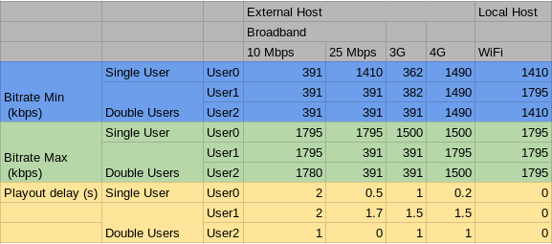
Analysis Results

Slide 23
Thank you

